Slide 1
Overview
of
Remote Sensing

Slide 2
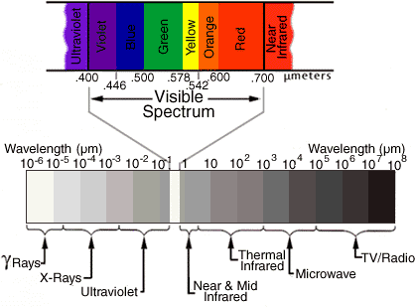
Notes:
The electromagnetic spectrum ranges from the shorter wavelengths (including gamma and x-rays) to the longer wavelengths (including microwaves and broadcast radio waves). There are several regions of the electromagnetic spectrum which are useful for remote sensing.

Slide 4
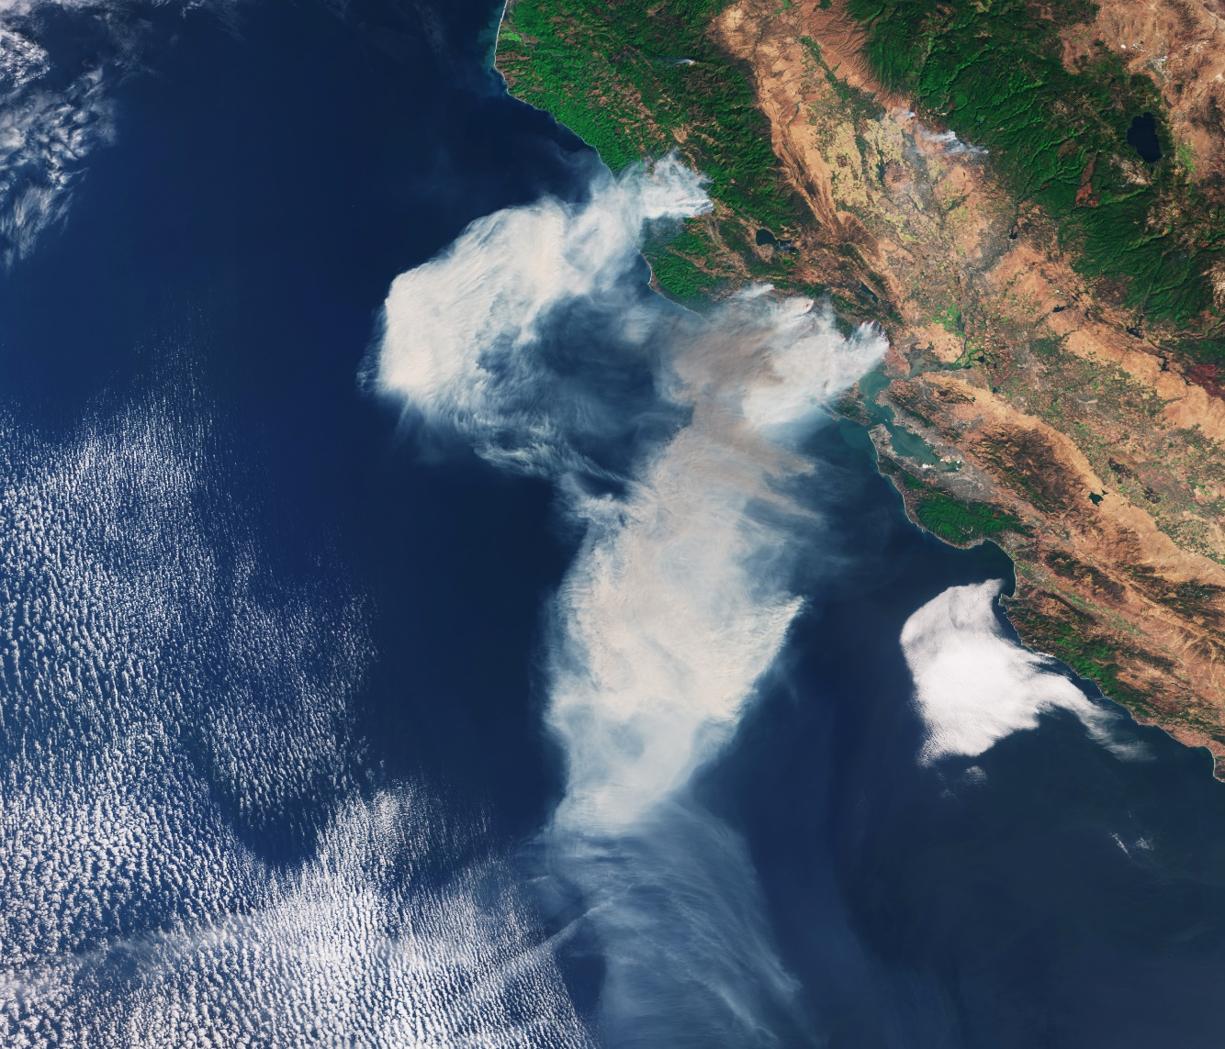
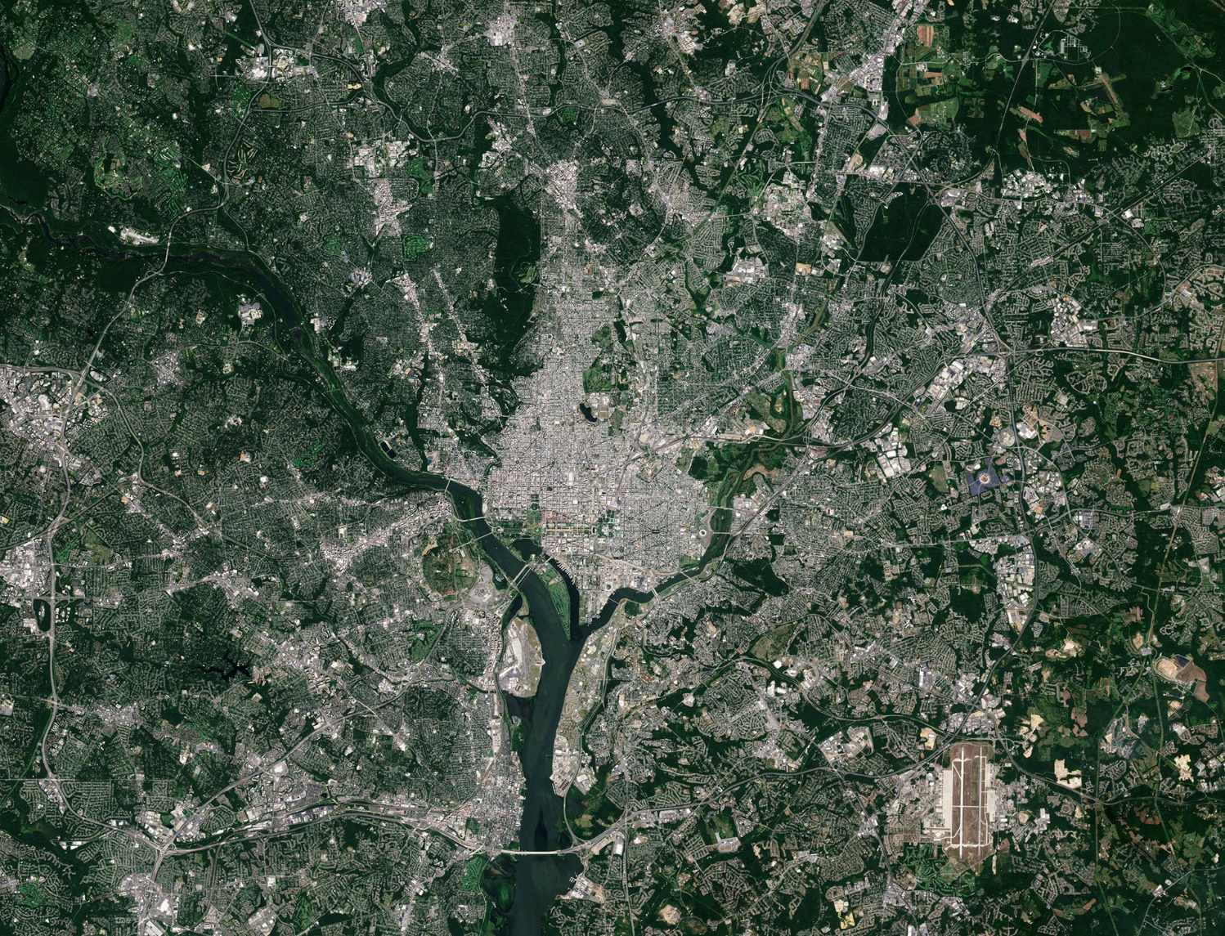
California Fire
Washington DC
Source: ESA

Slide 5
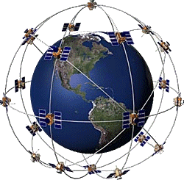
Global Positioning System (GPS)
24 Satellites
Precise
All weather
Any time and anywhere
Unlimited user capacity

Slide 6
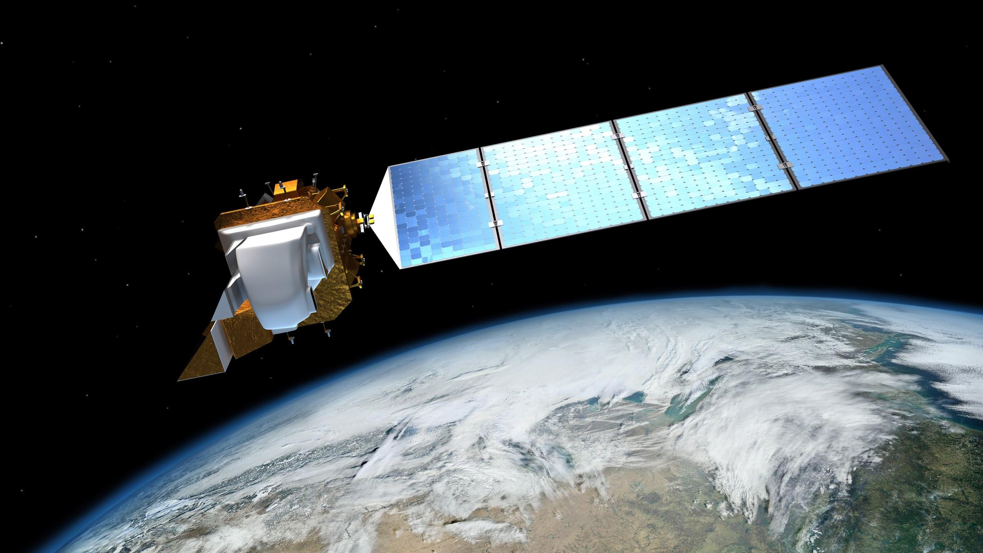
Remote Sensing Data Resources
Google Earth Engine https://earthengine.google.org
Earthexplorer http://earthexplorer.usgs.gov/
The USGS Global Visualization Viewer (GloVis) http://glovis.usgs.gov/
LPDAAC (Land Processes Distributed Archive Data Center) https://lpdaac.usgs.gov/data_access/data_pool
Earthdata https://search.earthdata.nasa.gov/
GDEx http://gdex.cr.usgs.gov/gdex/
Source: NASA

Slide 7
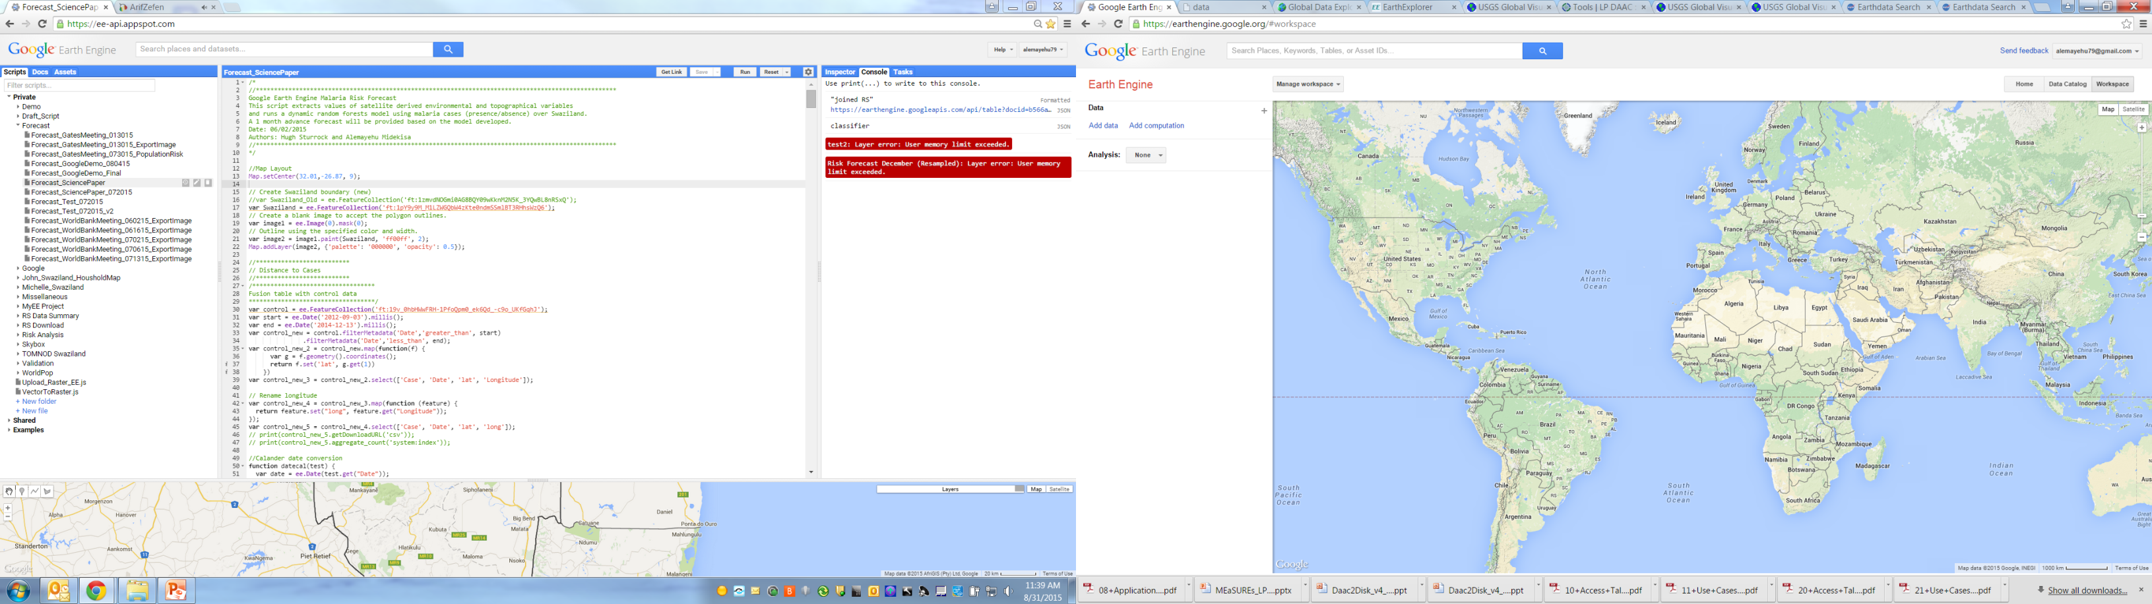
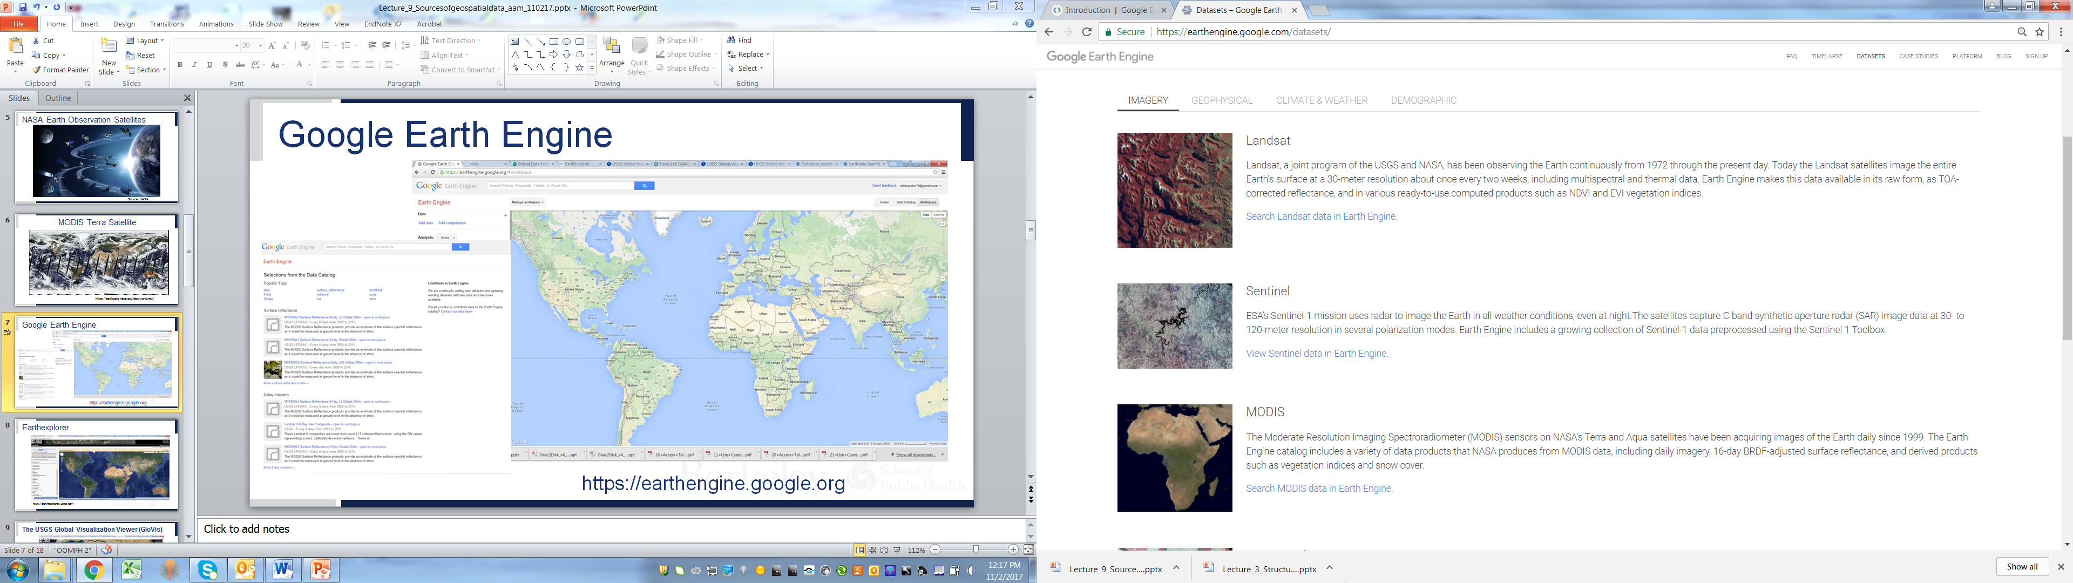
Google Earth Engine
https://earthengine.google.org

Slide 8
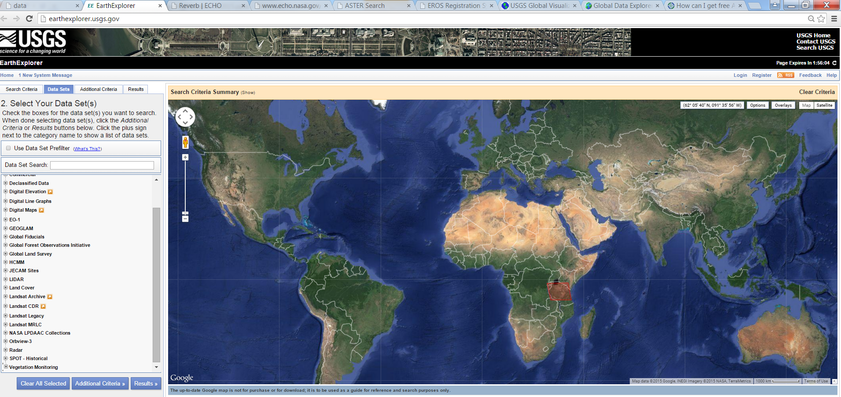
Earth Explorer
http://earthexplorer.usgs.gov/

Slide 9
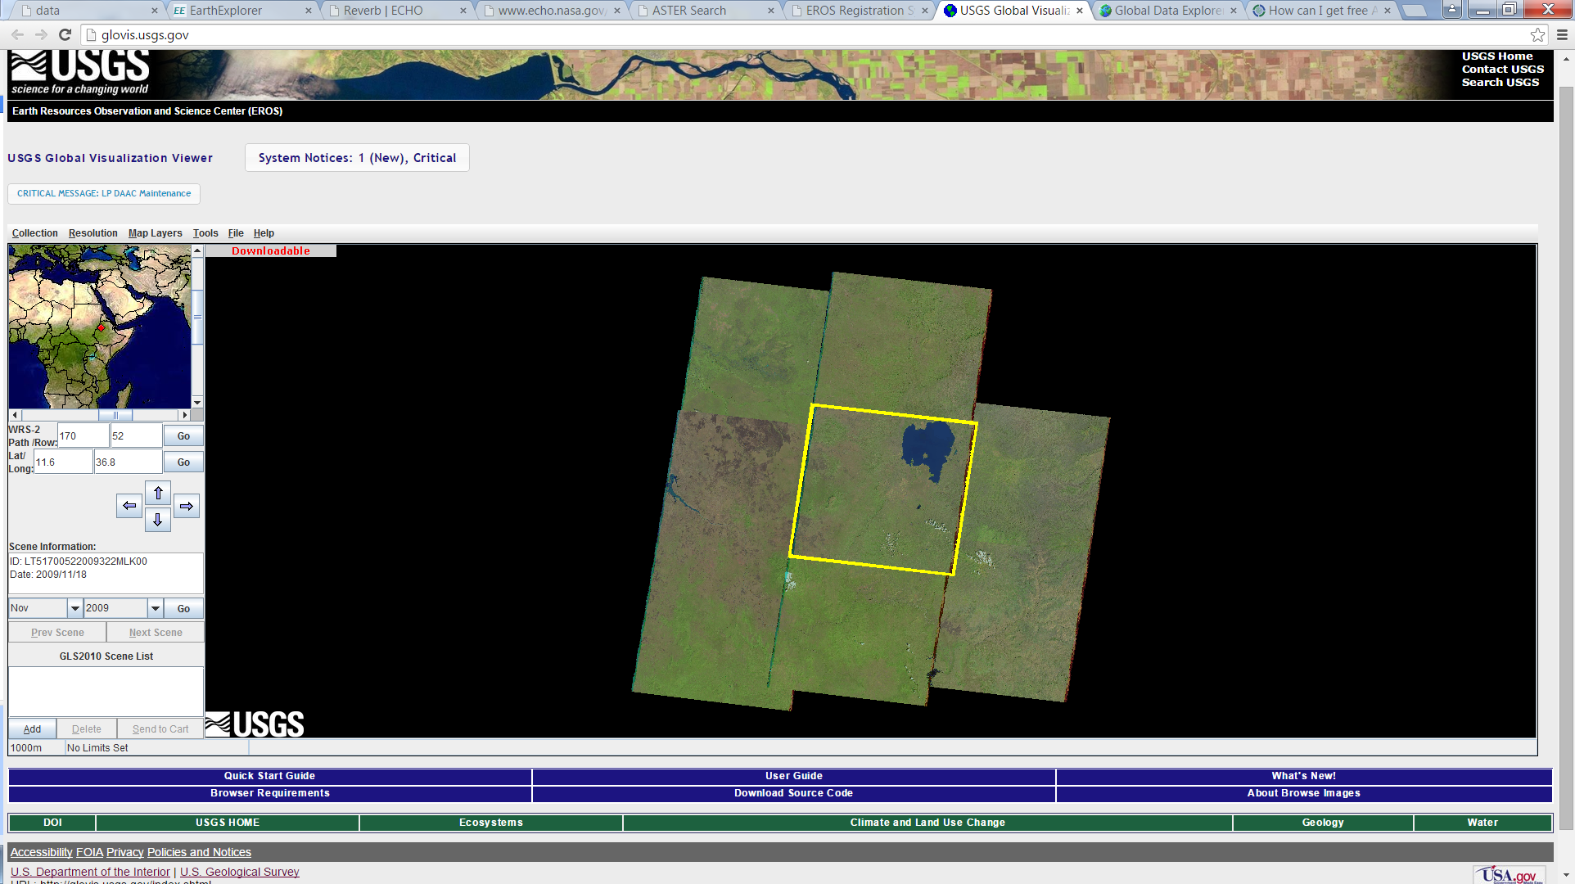
The USGS Global Visualization Viewer (GLOVIS)
http://glovis.usgs.gov/

Slide 10
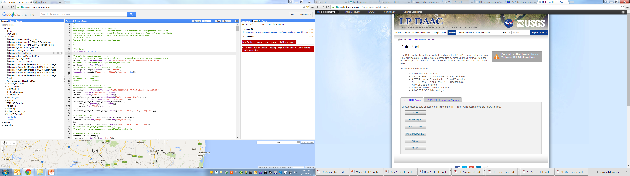
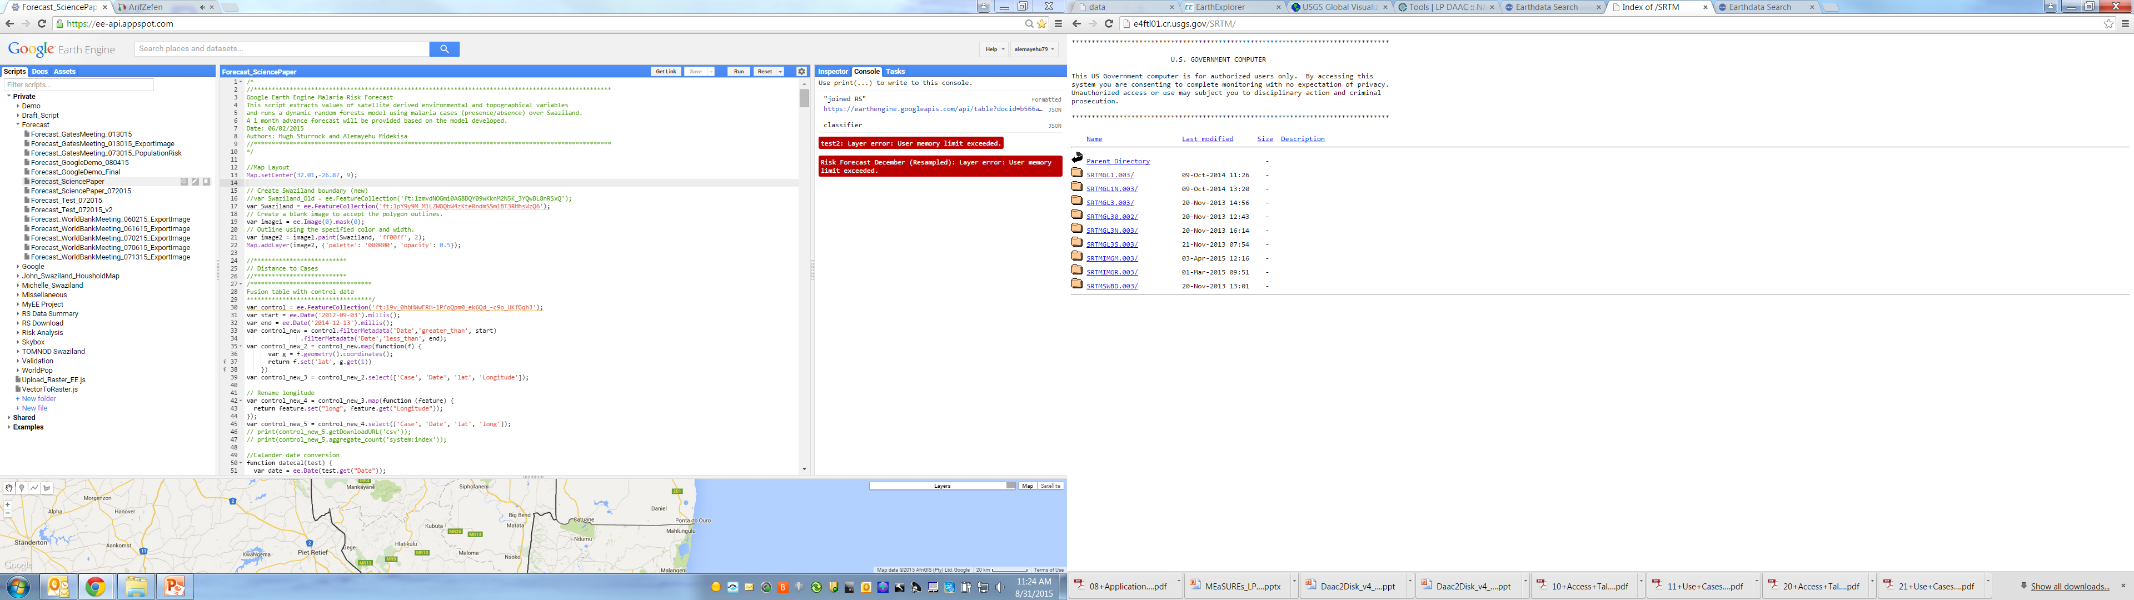
Land Processes Distributed Active Archive Data Center (LPDAAC)
ftp Access
https://lpdaac.usgs.gov/data_access/data_pool

Slide 11
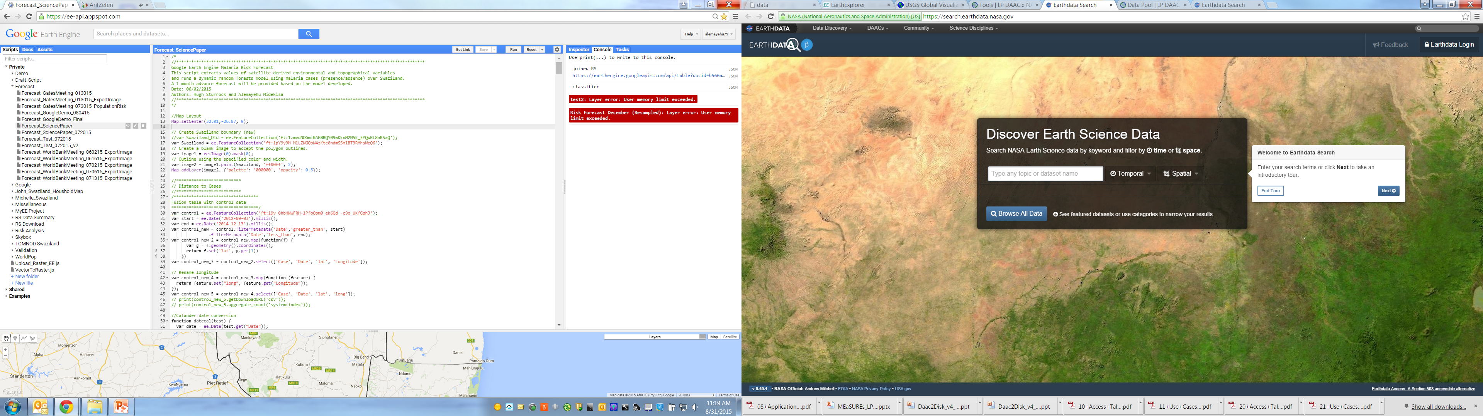
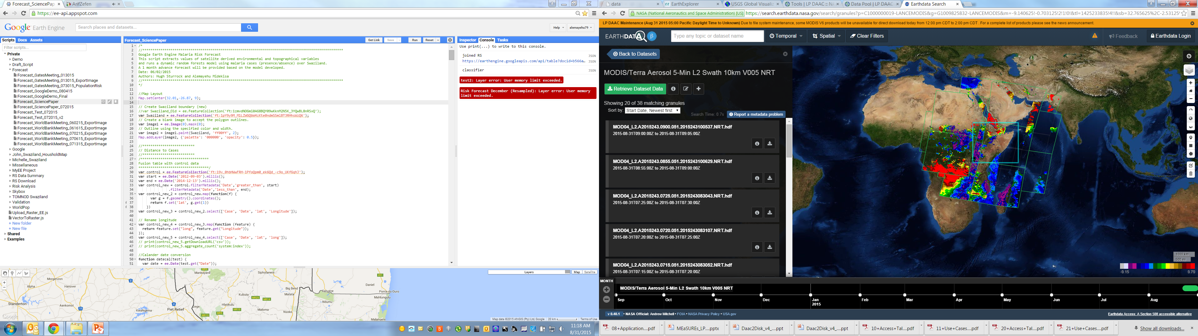
Earth Data
https://search.earthdata.nasa.gov/

Slide 12
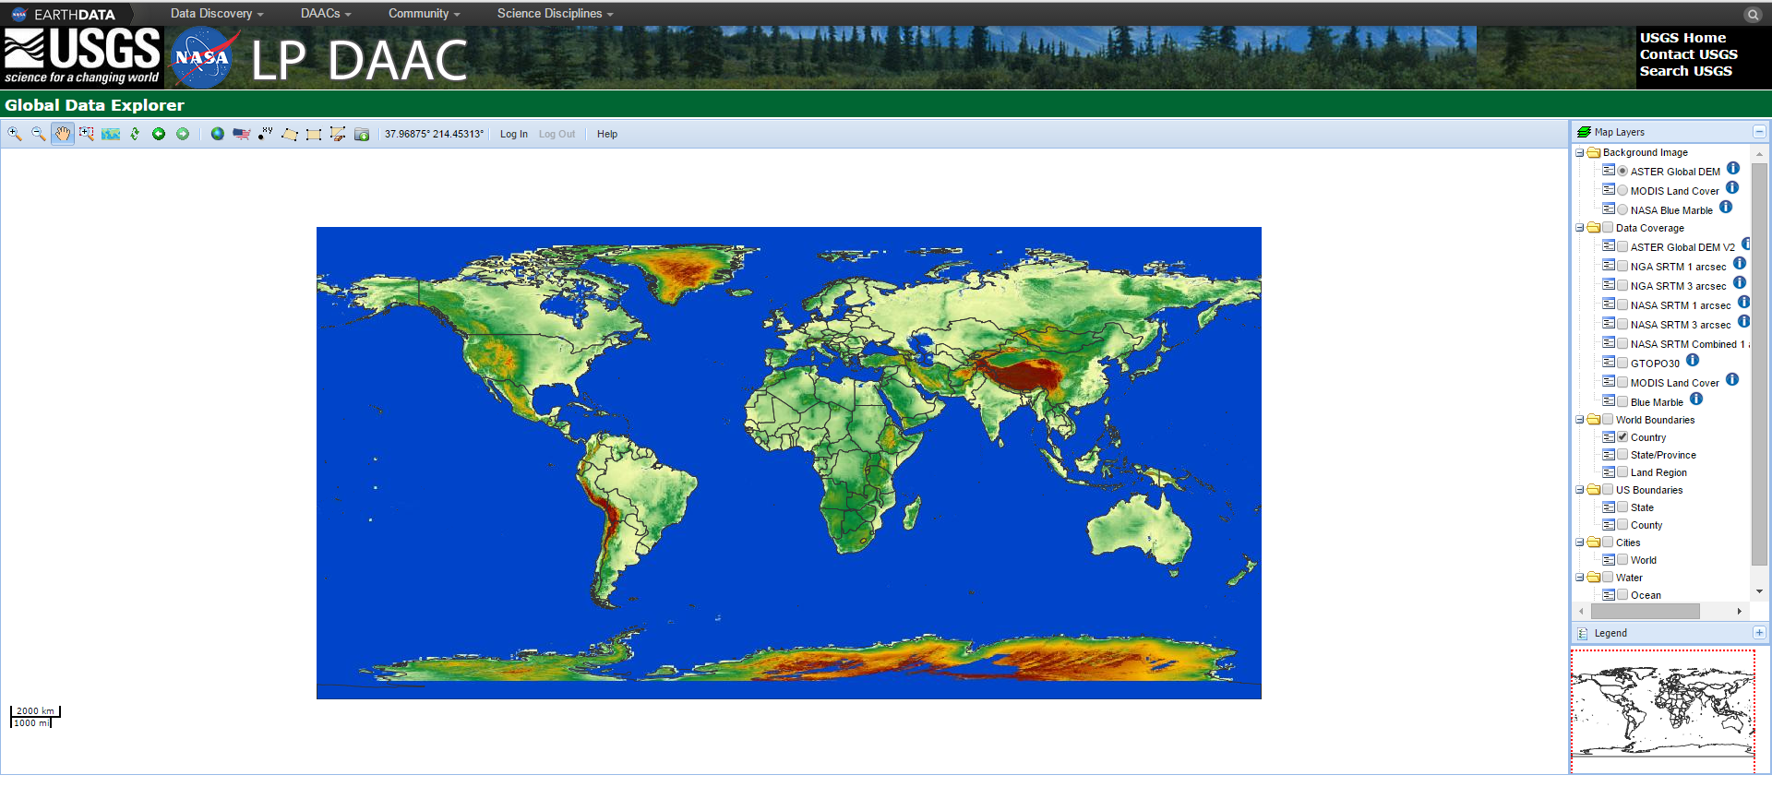
GDEx
http://gdex.cr.usgs.gov/gdex/

